Slide 1
Securing the SQL Server Data Platform
Preventing Data Loss and Ensuring Data Privacy

Slide 2

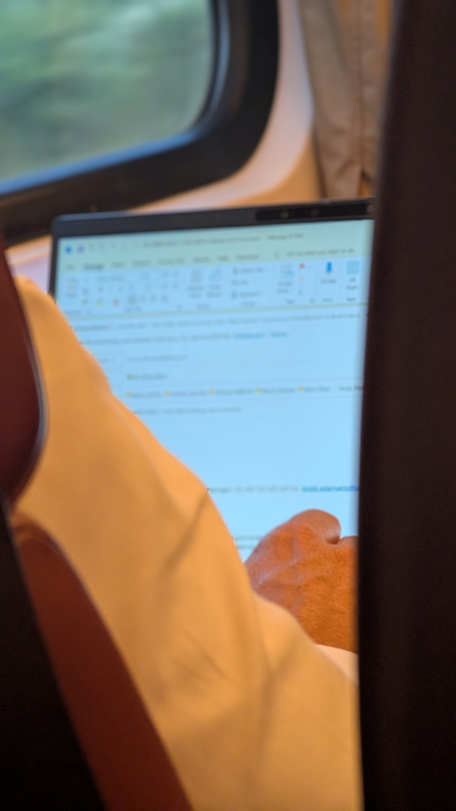


“It's not a matter of if, but when…”
Be aware of what you share

Slide 3




Danny de Haan
he/him
Solutions Engineer
Redgate Software
/in/dannydh/
ThatInfraDba@pm.me
www.thatinfradba.com

Slide 4
The SQL Server Threat Landscape
Why Security Matters
Network Attacks
SQL injection, denial of service
Data Breach
Exposure of sensitive information
Credential Theft
Password attacks, privilege escalation
Data Platform
Phishing
Social engineering, DB compromise
Insider Threats
Malicious or accidental access
Ransomware
Data encryption, extortion attacks

Slide 5
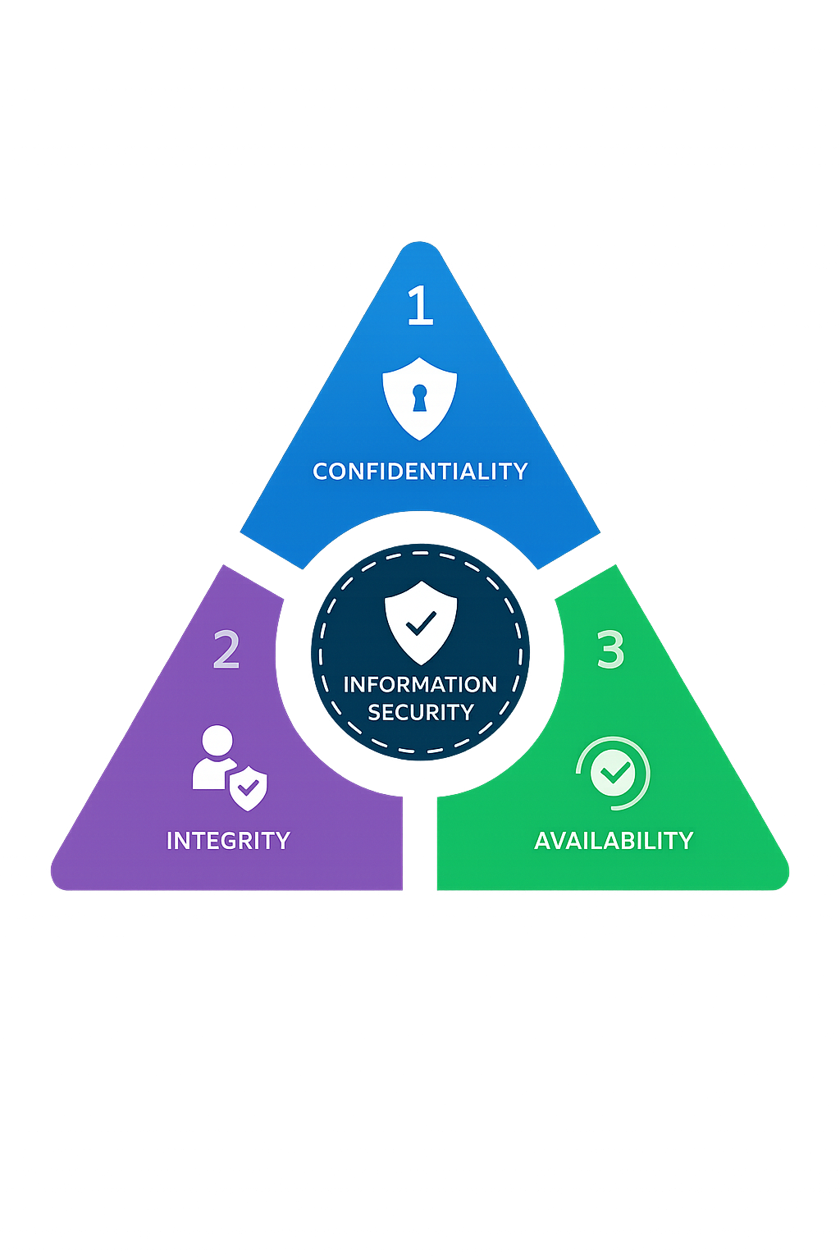
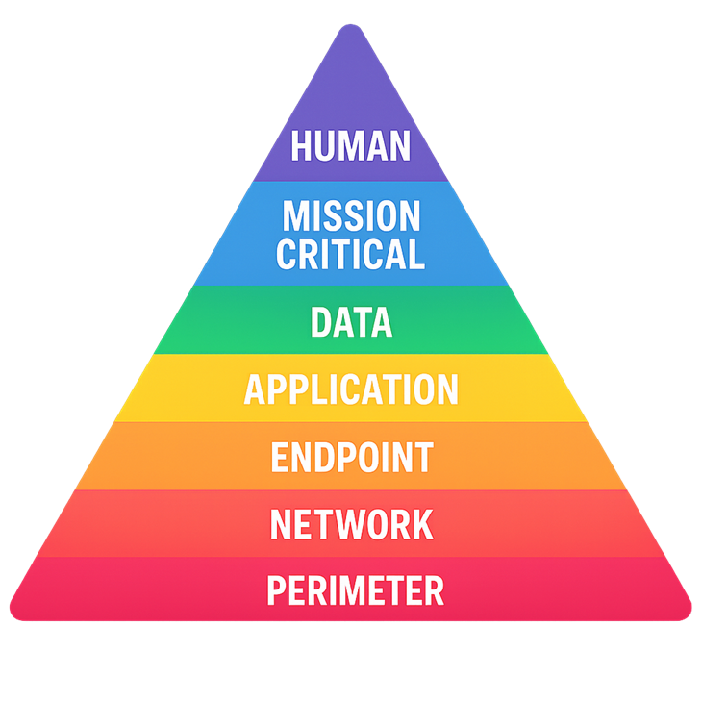
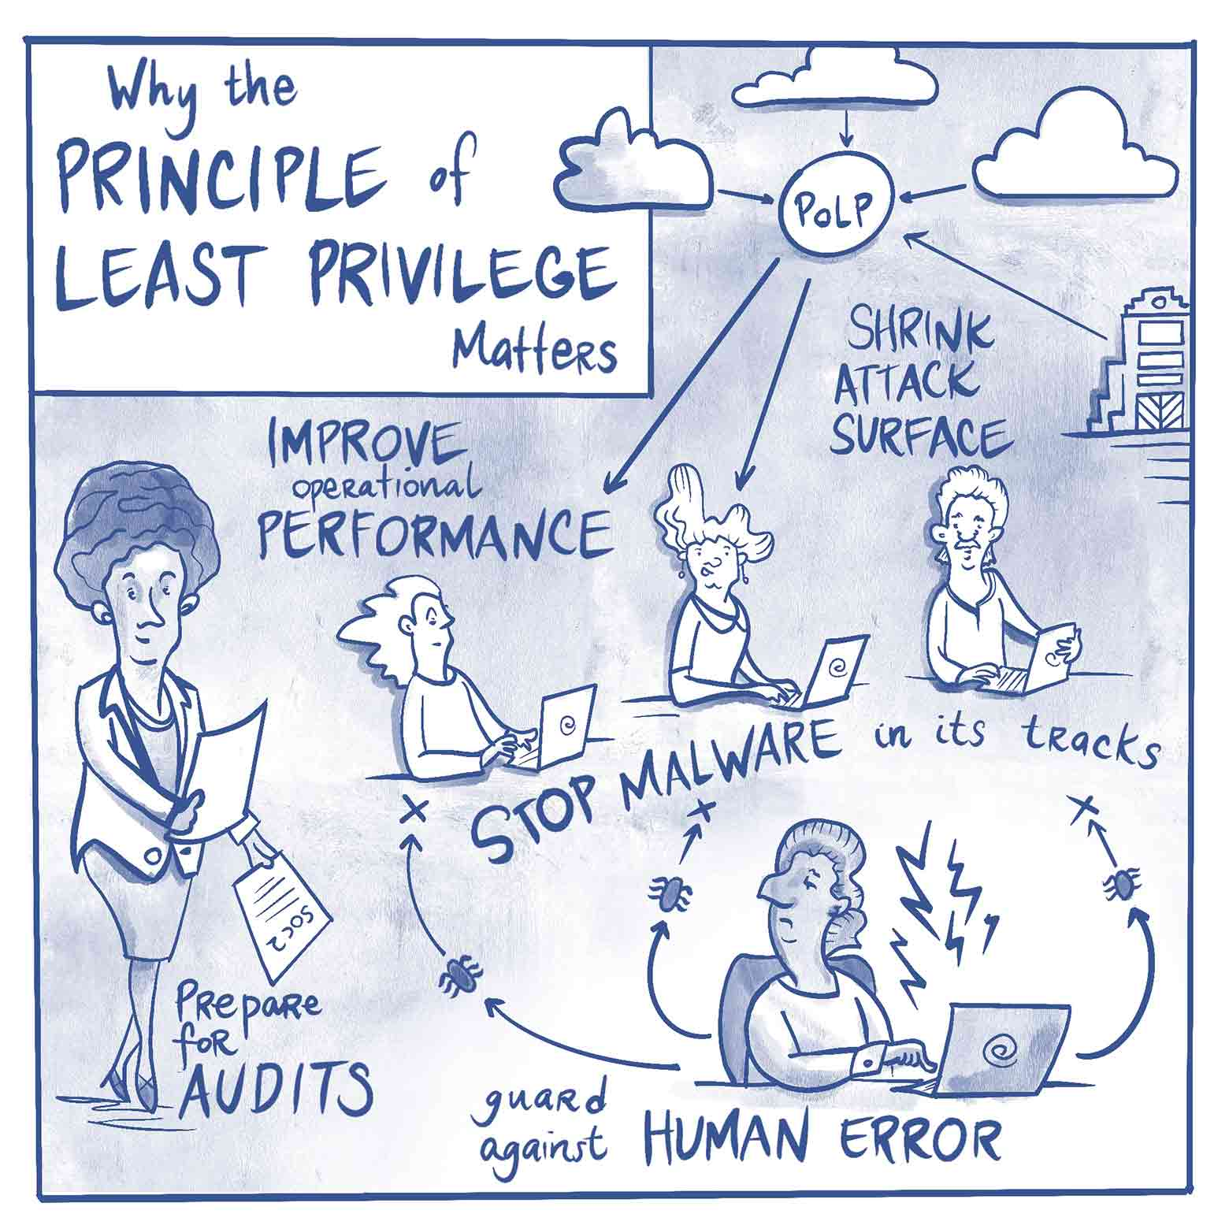
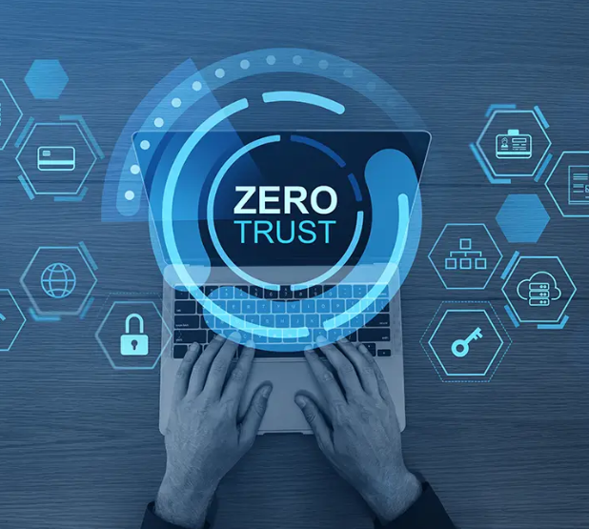
Core Security Principles
CIA Triad
Layered Security
Least privilege
Zero Trust
Attack surface

Slide 6
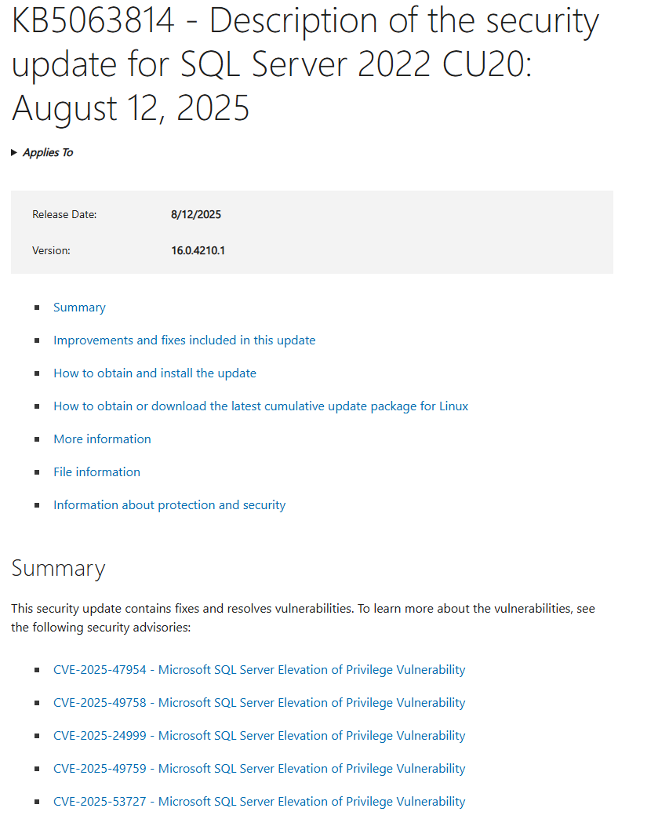
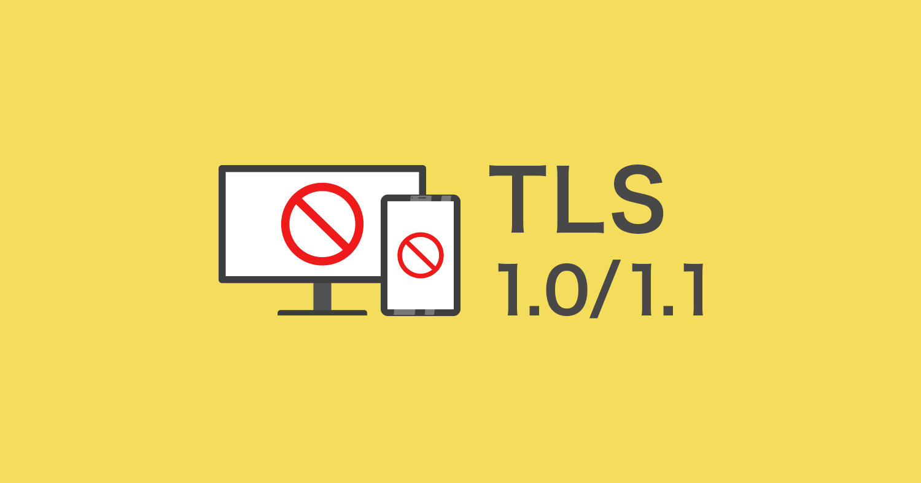
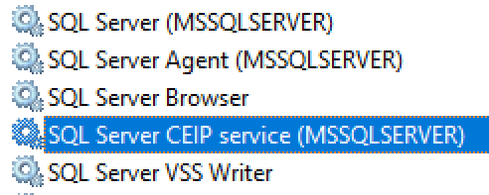
Reducing the Attack Surface
Unused features
Unnecessary Protocols & Services
Patching
Firewall & Network Segmentation

Slide 7
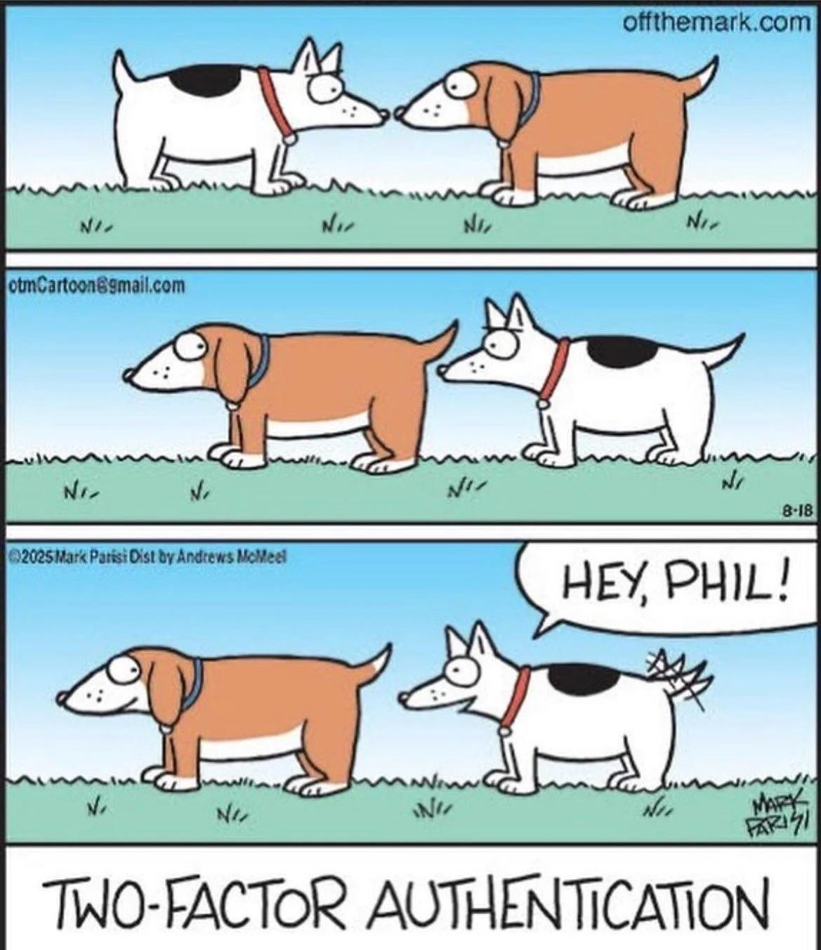
Authentication & Access Control
Windows vs SQL Authentication
Multi Factor Authentication
Role Based Access Control
Shared accounts
Access Review
SQL Server 2025 now uses PBKDF2 (RFC2898) for password hashing with 100,000 iterations, significantly slowing brute-force attacks

Slide 8
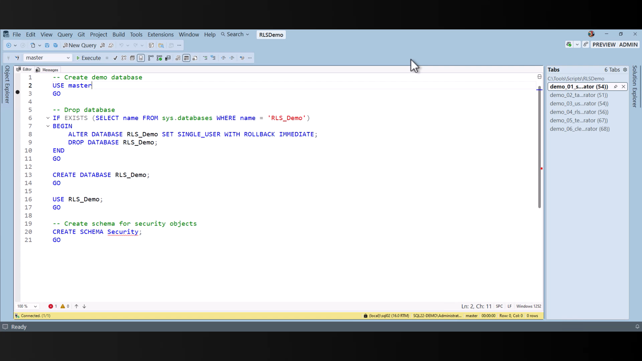

Slide 9
Encryption & Data Protection
Data in Transit
TLS encryption for all client-to-server and node-to-node communication
Certificate-based authentication across distributed endpoints
Data at Rest
Transparent Data Encryption (TDE) for relational stores
Volume-level and file-level encryption for document, graph & key-value stores
Envelope encryption with platform-managed or customer-managed keys
Data in Use
Column-level encryption & client-side encryption for sensitive fields
Confidential computing & secure enclaves for processing encrypted data
Dynamic data masking across all data models

Slide 10
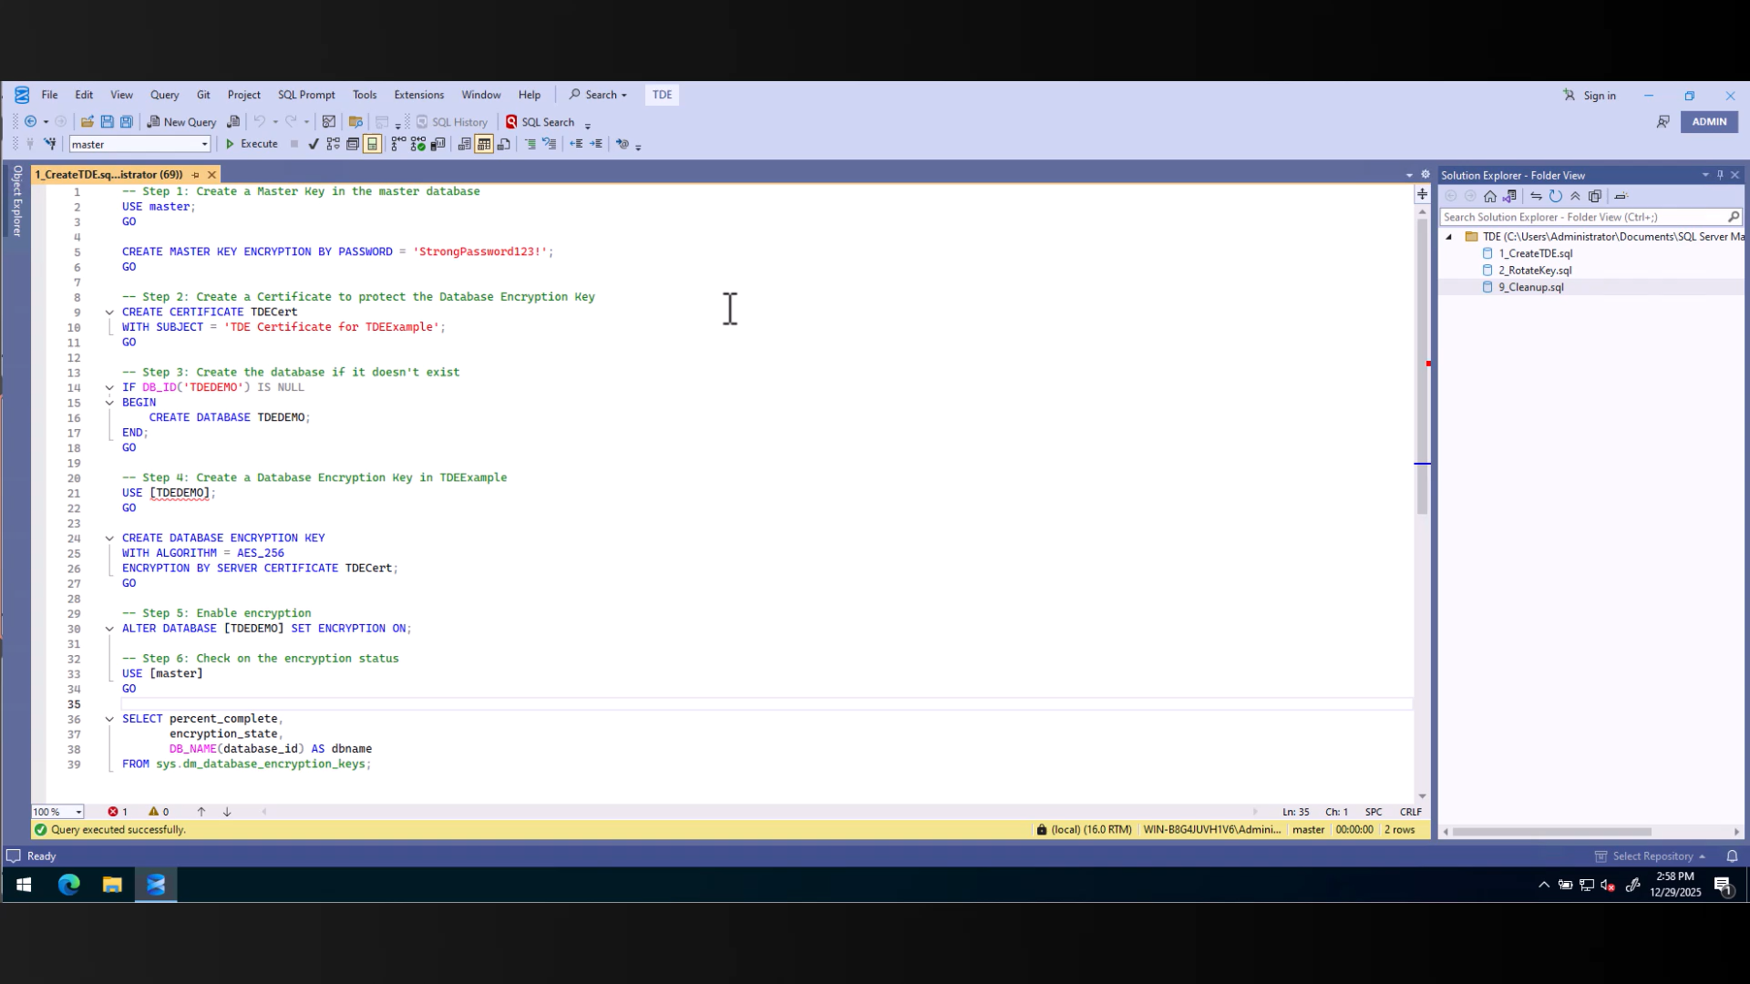

Slide 11
Back-up & Recovery Strategies
Last line of defense – Multi Tiered approach
Offsite/Immutable Tier 3
Recovery Time & Point Objectives
Test Test Test!

Slide 12
Monitoring & Incident Response
SQL Server Auditing & Extended Events
Alerting for suspicious behaviour
Incident Response Plan
Practice Practice Practise

Slide 13
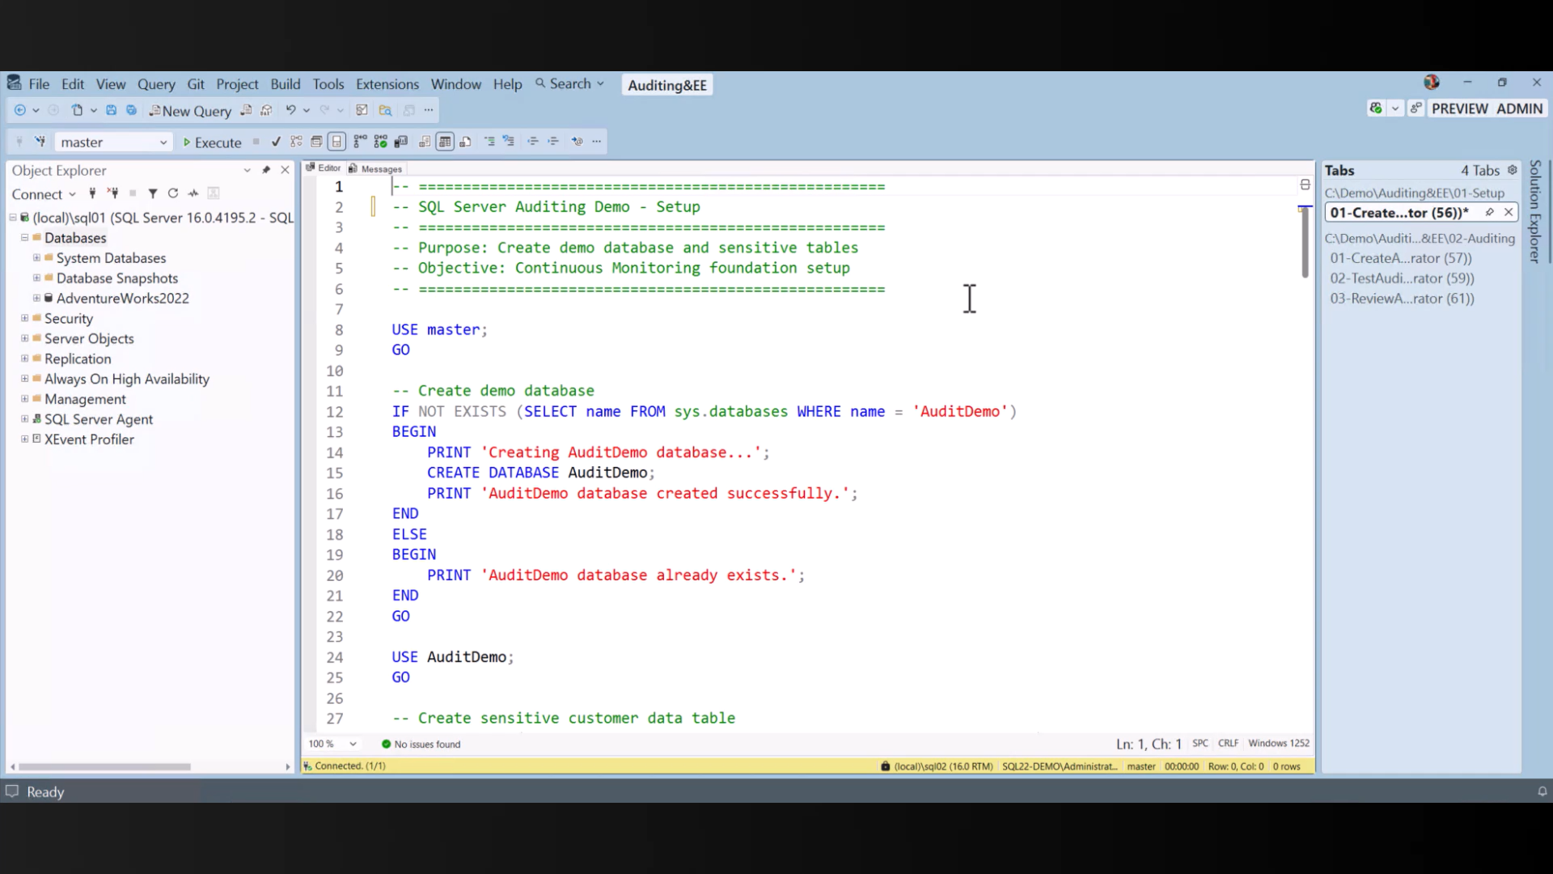

Slide 14
Key Takeaways
Security is proactive (even offline)
Layered defenses are essential (everywhere)
Review, Test & Adapt

Slide 15
Action Plan
Don’t wait for the breach; harden your platform today
Encrypt everything, trust nothing, grant only what’s needed
Test your backups and rehearse your response, before it’s real

